Slide 1
Natural language processing and LUIS

Slide 2







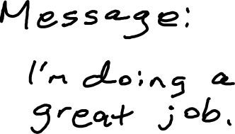

void Send_Click(object s, EventArgs e) {
string contact = txtTo.Text;
string message = txtMessage.Text;
SendMessage(contact, message)
}

Slide 3
Bots are just text-enabled apps

Slide 4
Tell Larry that I'm doing a great job.

Slide 5
Intent
Entities
SendMessage(contact, message)

Slide 6
Tell Larry that I'm doing a great job.
SendMessage("Larry", "I'm doing a great job")

Slide 7
Send a text to Larry.
SendMessage("Larry", null)

Slide 8
Send a message saying I'm doing a great job.
SendMessage(null, "I'm doing a great job")

Slide 9
Send a message.
SendMessage(null, null)

Slide 10
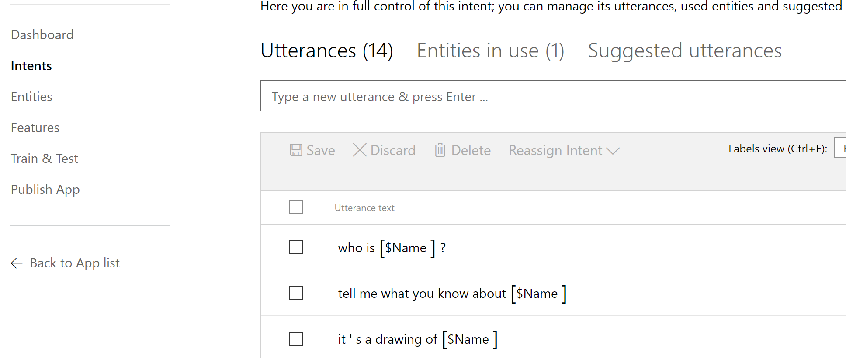
LUIS and Bots
Language Understanding Intelligence Service
Trains utterances (examples) into a REST API
Maps utterances to intents (verbs) and extracts entities

Slide 11
Training LUIS
Notes:
Show:
Train a LUIS model
Add LUIS to a C# and Node.js bot

Slide 12
Improving LUIS

Slide 13
Programming LUIS
Consuming LUIS
C#
Add attribute to dialog
Node.js
Add LUIS recognizer
Updating LUIS
Full API available

Slide 14
Adding Entities
Prebuilt
Time, encyclopedia, etc.
List
"Closed list"
No fuzzy logic
No learning
Always matches
Simple
Learned entities
Hierarchical
Parents and subtypes
Employee > PartTime, FullTime
Composite
Made up of other entities

Slide 15
Features
Phrase lists
Unlike closed lists, these involve learning
Seed LUIS to teach it possible values in advance
Useful for technical terms or words outside of the domain
Pattern features
Teach LUIS what things look like
SKUs, invoice numbers, etc.

Slide 16
Enhancing a model

Slide 17
Overuse of natural language processing
A bot with a single dialog using 100 LUIS intents is a bad design:
1 question
100 different things your bot can do (intents)
100 different utterances (examples) per intent
= 10,000 different things users may say (plus the other N possibilities you didn’t predict)
Users will only guess 3 or so things from 100
So you might have wasted 97% of your code
Hello user! How can I help you?

Slide 18
Uncanny valley
Rock Human
Notes:
Draw chart and talk to uncanny valley

Slide 19
Impact of the uncanny valley when building bots
The more your bot pretends to be a human, the more the human will expect
Humans will "down-level" to the bot
Don't try to solve the Turing test
Allow for terse statements
Good for small keyboards anyway
Be clear about what the bot can do
Provide guidance
"You could say ..."
Buttons are a good thing

Slide 20
LUIS training best practices
More utterances the better
Treat it like a closed universe
Don't use LUIS to allow the user to type anything
Train up the none intent
Use caution with Scorables and triggerAction
LUIS can accidentally redirect the user
All calls are sent to LUIS

Slide 21
Ensuring success with LUIS

Slide 22
But what about speech?

Slide 23

Do you really need speech support?

Slide 24
Speech isn't good for all scenarios
Audio quality
Location
User experience

Slide 25
Bing Speech
Does speech to text conversions
Send the text to LUIS
Genericized conversion

Slide 26
Custom Speech Service
Custom models
Train for your domain
Adjust for background noise

Slide 27
Bing Speech vs Custom Speech Service

Slide 28
Your turn
Allow the user to describe their problem
Continue to collect the same data as before
Prompt for missing information

